Slide 1

HR Analysis
with
Power BI and Excel
PYSILQ Internship Project Presented by :
Neha Goyal

Slide 2

Contents
About Dataset
Entity Relationship
Objective
Problem Statements with Solutions
Dashboard
Insights

Slide 3
About Dataset
The Data is located across multiple Excel Files.
The Data consist of 4410 records over 24 attributes in tabular form.
By exploring our Data, it appears to be clean and ready to go.

Slide 4
Entity Relationship

Slide 5
Objective
This HR data analysis project aims to leverage Excel and Power BI to derive actionable insights from our workforce data. By uncovering trends and patterns, we'll empower decision-makers to optimize talent management strategies, enhance employee engagement, and drive organizational success. Through meticulous analysis and innovative visualization, we'll foster a culture of data-driven HR excellence, ensuring our company remains competitive and agile in today's dynamic business environment.

Slide 6

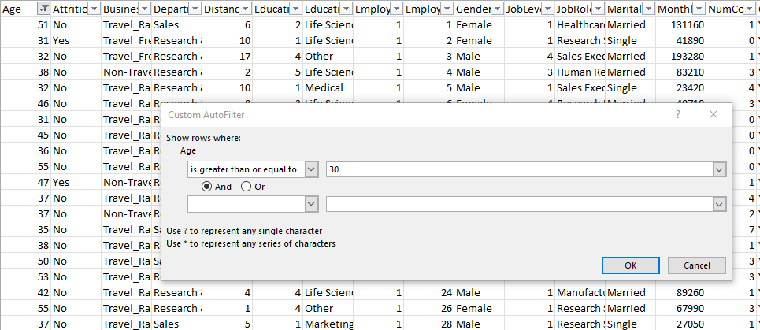
Problem Statements with Solutions
Q-1 Using Excel, how would you filter the dataset to only show employees aged 30 and above?

Slide 7
Q-2 Create a pivot table to summarize the average Monthly Income by Job Role.
Problem Statements with Solutions

Slide 8
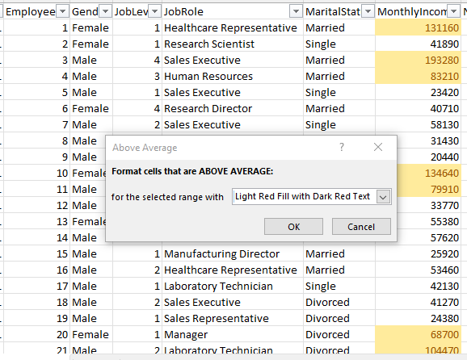
Problem Statements with Solutions
Q-3 Apply conditional formatting to highlight employees with Monthly Income above the company's average income.

Slide 9
Problem Statements with Solutions
Q-4. Create a bar chart in Excel to visualize the distribution of employee ages.

Slide 10
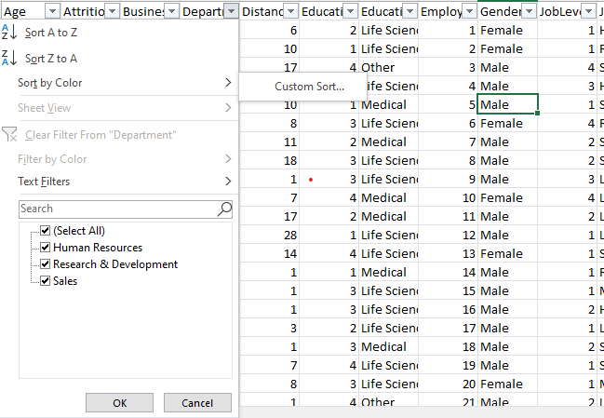
Problem Statements with Solutions
Q-5. Identify and clean any missing or inconsistent data in the "Department" column.
There are no missing values in the Department column.

Slide 11
Problem Statements with Solutions
Q-6. In Power BI, establish a relationship between the "EmployeeID" in the employee data and the "EmployeeID" in the time tracking data.

Slide 12
Problem Statements with Solutions
Q-7. Using DAX, create a calculated column that calculates the average years an employee has spent with their current manager.

Slide 13
Problem Statements with Solutions
Q-8. Using Excel, create a pivot table that displays the count of employees in each Marital Status category, segmented by Department.
Marital status under Department | Count of EmployeeID
Human Resources | 189
Divorced | 21
Married | 96
Single | 72
Research & Development | 2883
Divorced | 621
Married | 1350
Single | 912
Sales | 1338
Divorced | 339
Married | 573
Single | 426
Grand Total | 4410

Slide 14
Problem Statements with Solutions
Q-9. Apply conditional formatting to highlight employees with both above-average Monthly Income and above-average Job Satisfaction.
EmployeeID | MonthlyIncome | JobSatisfaction
1 | 131160 | 4
2 | 41890 | 2
3 | 193280 | 2
4 | 83210 | 4
5 | 23420 | 1
6 | 40710 | 2
7 | 58130 | 3
8 | 31430 | 2
9 | 20440 | 4
10 | 134640 | 1
11 | 79910 | 4
12 | 33770 | 4
13 | 55380 | 1
14 | 57620 | 2
15 | 25920 | 4
16 | 53460 | 4
17 | 42130 | 3
18 | 41270 | 4
19 | 24380 | 2
20 | 68700 | 1
21 | 104470 | 2
22 | 96670 | 2
23 | 21480 | 3

Slide 15
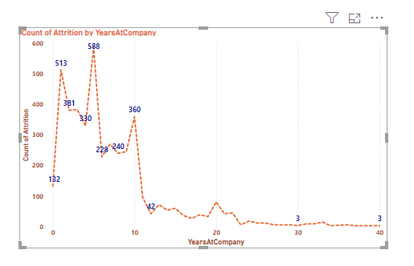
Problem Statements with Solutions
Q-10. In Power BI, create a line chart that visualizes the trend of Employee Attrition over the years.

Slide 16
Problem Statements with Solutions
Q-11. Describe how you would create a star schema for this dataset, explaining the benefits of doing so.
To create a star schema for this dataset:
Identify Fact Table: Choose a central fact table containing core HR metrics like Monthly Income, Performance Rating, and YearsAtCompany.
Create Dimension Tables: Design separate dimension tables for attributes such as EmployeeID, Department, Job Role, and Survey responses.
Establish Relationships: Define relationships between the fact table and dimension tables using primary and foreign keys to link related data.
Optimize Performance: Utilize star schema's simplified structure to enhance query performance, as it reduces the need for complex joins.
Enable Scalability and Analysis: Enjoy the benefits of scalability and streamlined analysis, allowing for efficient reporting and adaptable data management as HR needs to evolve.

Slide 17
Problem Statements with Solutions
Q-11. Describe how you would create a star schema for this dataset, explaining the benefits of doing so.
Benefits are:
Identify Fact Table: Choose a central fact table containing core HR metrics like Monthly Income, Performance Rating, and YearsAtCompany.
Create Dimension Tables: Design separate dimension tables for attributes such as EmployeeID, Department, Job Role, and Survey responses.
Establish Relationships: Define relationships between the fact table and dimension tables using primary and foreign keys to link related data.
Optimize Performance: Utilize star schema's simplified structure to enhance query performance, as it reduces the need for complex joins.
Enable Scalability and Analysis: Enjoy the benefits of scalability and streamlined analysis, allowing for efficient reporting and adaptable data management as HR needs to evolve.

Slide 18
Problem Statements with Solutions
Q-12 Using DAX, calculate the rolling 3-month average of Monthly Income for each employee.

Slide 19
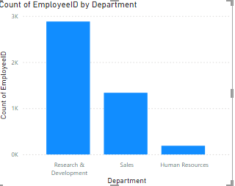
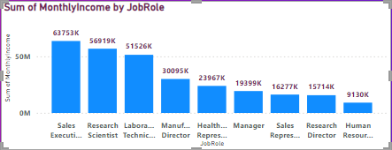
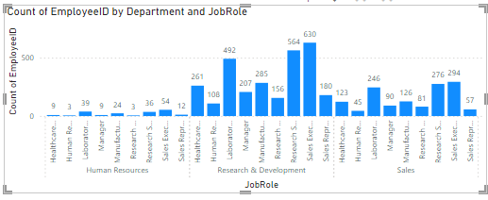

Problem Statements with Solutions
Q-13 Create a hierarchy in Power BI that allows users to drill down from Department to Job Role to further narrow their analysis.

Slide 20

Problem Statements with Solutions
Q-14. How can you set up parameterized queries in Power BI to allow users to filter data based 2 of 2 on the Distance from Home column?
To set Parameterized in PowerBI:
Open Query Editor: Access Power BI's Query Editor.
Create Parameters: Make two parameters for Minimum and Maximum Distance values.
Filter Data: Set up a filter for the Distance from Home column, using the parameters for the range.
Apply Changes: Confirm the filter settings and apply them.
Use Parameters: Now adjust the parameters to dynamically filter the data based on Distance from Home.

Slide 21
Problem Statements with Solutions
Q-15. In Excel, calculate the total Monthly Income for each Department, considering only the employees with a Job Level greater than or equal to 3.
Dept and Job Role | Sum of MonthlyIncome
Human Resources | 3259140
3 | 1648500
4 | 754800
5 | 855840
Research & Development | 53502900
3 | 28117740
4 | 15277290
5 | 10107870
Sales | 22974330
3 | 11792400
4 | 8753070
5 | 2428860
Grand Total | 79736370

Slide 22
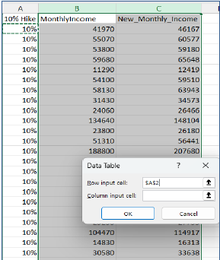
Problem Statements with Solutions
Q-16. Explain how to perform a What-If analysis in Excel to understand the impact of a 10% increase in Percent Salary Hike on Monthly Income.
Answer
Go to the "Data" tab.
In the "Data Tools" group, click "What-If Analysis" and choose "Data Table."
In "Row input cell," enter the reference to the cell with Percent Salary Hike.
click ok.

Slide 23
Problem Statements with Solutions
Q-17. Verify if the data adheres to a predefined schema. What actions would you take if you find inconsistencies?
To verify if the data adheres to a predefined schema:
Review predefined schema: Ensure understanding of attribute names, types, and relationships.
• Inspect data for inconsistencies: Utilize data profiling tools to identify disparities.
• Identify missing or incorrect values: Scrutinize mandatory fields for completeness and accuracy.
• Document issues and impact: Detail the significance of inconsistencies in analysis and decision-making.
• Cleanse, standardize, and enforce constraints: Rectify data anomalies and establish validation rules.
• Communicate findings to stakeholders: Foster collaboration by sharing insights with relevant parties.
• Implement ongoing monitoring for data quality: Set up regular audits to sustain high standards of accuracy and reliability.

Slide 24
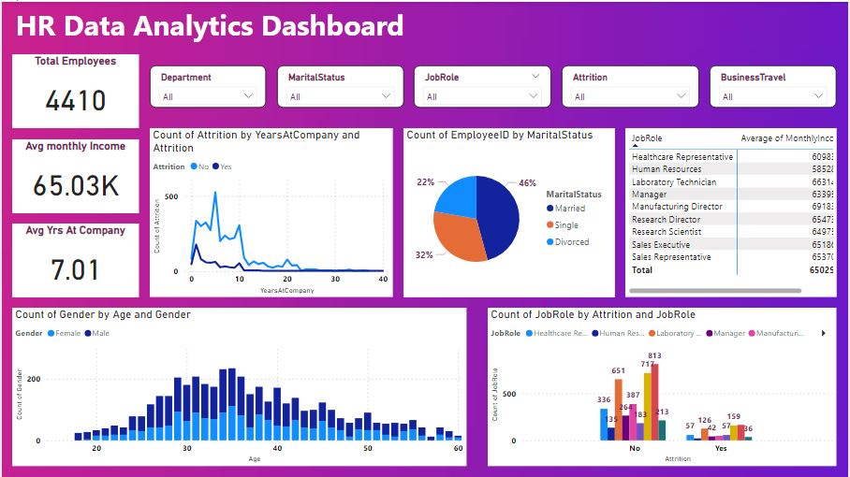
Dashboard

Slide 25
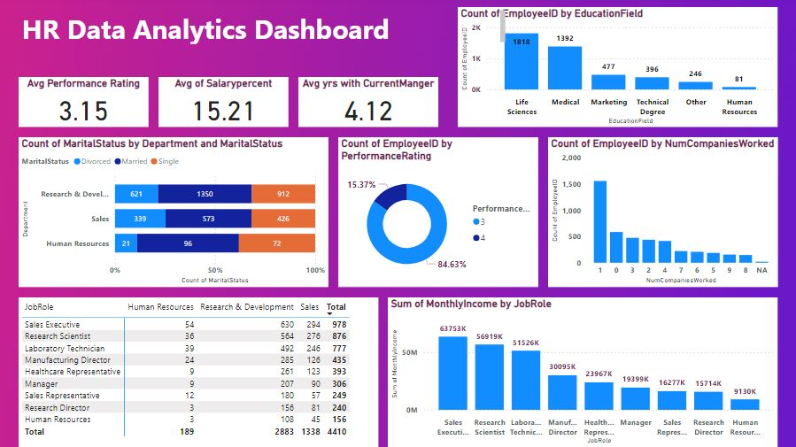
Dashboard

Slide 26
Create a bar chart to visualize the distribution of employees by department, providing an at-a-glance overview.
Develop a slicer enabling users to filter employees based on their job roles, Department, Marital Status enhancing user interactivity.
Create a calculated column determining the age group of employees, enhancing demographic insights.
Calculate the average monthly income for employees using DAX and display the result in a card visualization.
Use DAX to calculate year-over-year growth in monthly income for employees, providing insights into income trends.
Establish a hierarchy for department and Job role columns to facilitate drill-down analysis, streamlining temporal exploration.
Utilize DAX to calculate the moving average of monthly income over a rolling 3-month period, providing trend insights.
Use What-If parameters to illustrate how attrition rates change when adjusting factors such as salary increases.
Insights

Slide 27
Thank You

